Slide 1
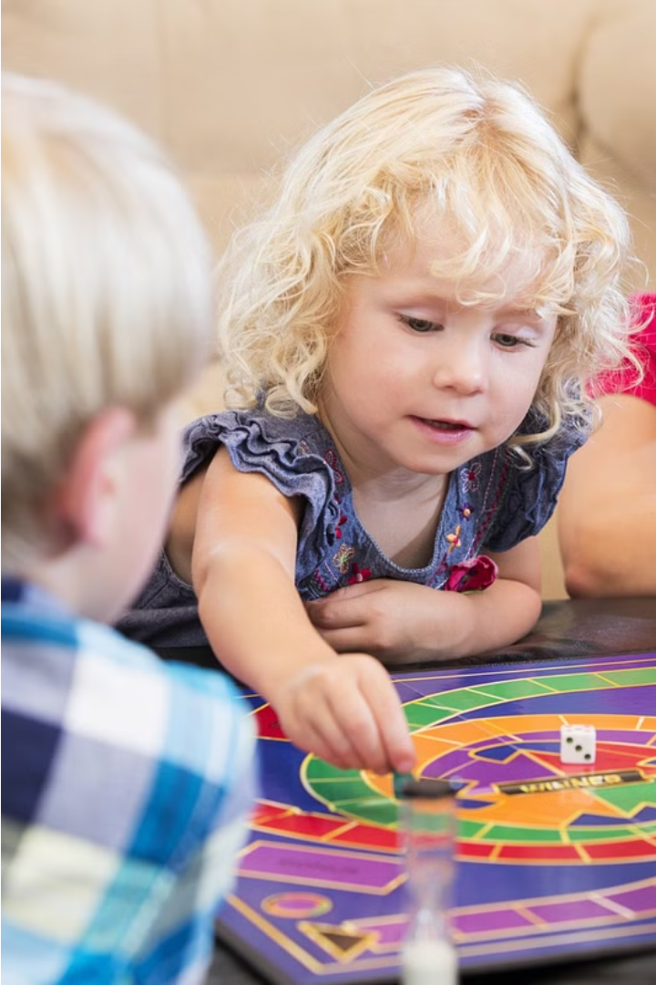

Enhancing Learning for Dyslexic Children through Gamified Education
Addressing the unique challenges faced by dyslexic children, this gamified learning app leverages interactive games and progress tracking to improve their learning abilities and foster an engaging educational experience.
by 1005 AARON JOEL
by 1009 ABESHEK SRIKANTH

Slide 2

Existing System
Seeing AI
Voice Dream Reader
Microsoft's Seeing AI, a refined iOS app, It aids visually impaired users.
helps kids with speech difficulties communicate. Bottom Line
Simplex Learning
education consulting group that provides strategic advice to school districts, schools, and education leaders of various areas

Slide 3
PROPOSED SYSTEM
Gamified Learning App
Points and Levels
Customized Gaming Program
Progress Tracking
The proposed system is a gamified learning app designed to help dyslexic children improve their learning abilities through interactive games and regular progress tracking.
The app will award points to children based on their performance in the learning games. These points will be used to analyze their progress and customize the game program accordingly.
The app will regularly monitor the child's progress and provide feedback to parents and teachers, enabling them to support the child's learning journey.
Based on the child's performance and progress, the app will create a personalized gaming program to address their specific learning needs and challenges.

Slide 4
METHODOLOGY
1
Data Collection
Gather data on learning behaviors and progress of dyslexic children
2
Game Design
Create engaging, gamified learning activities tailored to dyslexic needs
Progress Tracking
3
Implement a system to monitor and analyze each child's performance
Personalization
4
Use data to adapt the gaming program to each child's unique learning style
The methodology for this gamified learning app involves a multi-faceted approach. First, we will collect detailed data on the learning behaviors and progress of dyslexic children. This will inform the design of engaging, gamified learning activities specifically tailored to their needs. We will then implement a robust system to continuously monitor and analyze each child's performance, allowing us to personalize the gaming program for maximum impact.

Slide 5

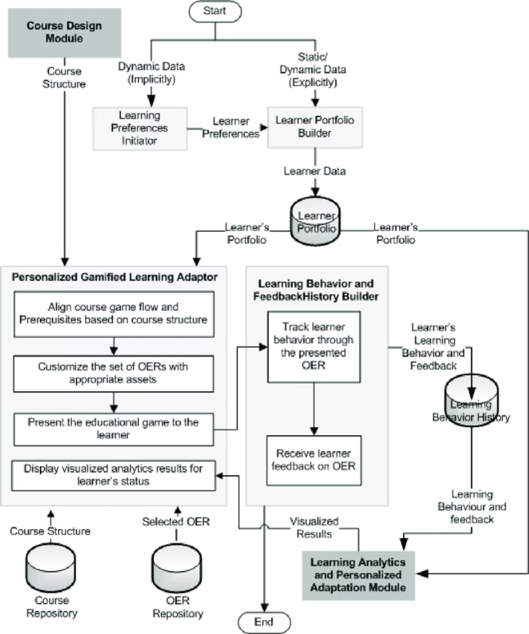
Implementation Model Flow Chart
The implementation model for the gamified learning app for dyslexic children follows a comprehensive flow chart. This visual representation outlines the key steps, from initial user onboarding to the adaptive, personalized gaming program tailored to each child's progress and needs.
The flow chart tracks the seamless integration of user input, performance tracking, and dynamic adjustments to the gaming experience, ensuring a truly personalized and effective learning journey for every dyslexic child who uses the app.

Slide 6

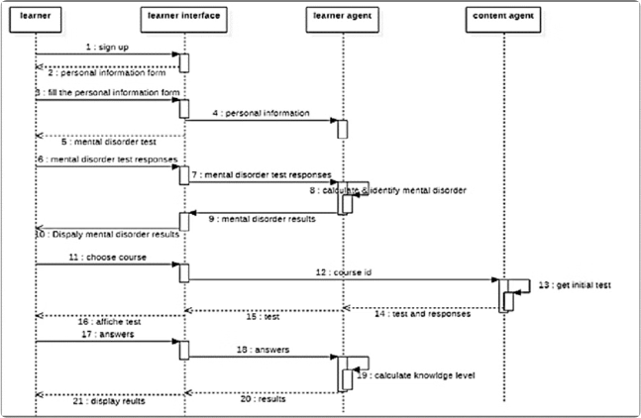
Sequence Diagram
The implementation model for the gamified learning app for dyslexic children follows a comprehensive flow chart. This visual representation outlines the key steps, from initial user onboarding to the adaptive, personalized gaming program tailored to each child's progress and needs.
The flow chart tracks the seamless integration of user input, performance tracking, and dynamic adjustments to the gaming experience, ensuring a truly personalized and effective learning journey for every dyslexic child who uses the app.

Slide 7

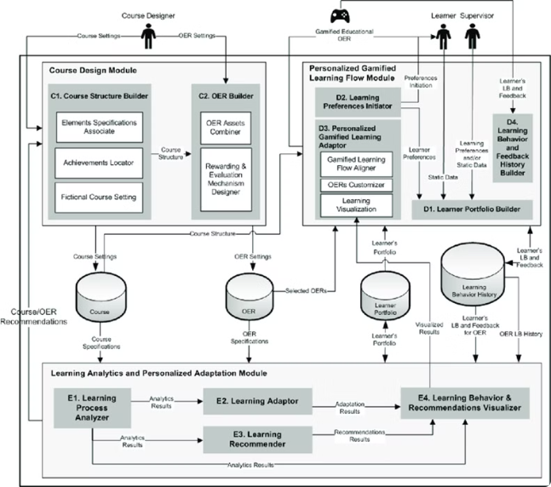
ARCHITECTURE DIAGRAM
The implementation model for the gamified learning app for dyslexic children follows a comprehensive flow chart. This visual representation outlines the key steps, from initial user onboarding to the adaptive, personalized gaming program tailored to each child's progress and needs.
The flow chart tracks the seamless integration of user input, performance tracking, and dynamic adjustments to the gaming experience, ensuring a truly personalized and effective learning journey for every dyslexic child who uses the app.

Slide 8



DATA PREPARATION
Data Collection
Data Cleaning
Data Analysis
Gather data from various sources, including user interactions, game performances, and user feedback surveys.
Clean and preprocess the data, handling missing values, removing outliers, and ensuring data integrity.
Analyze the data to identify patterns, trends, and insights that can inform the gamified learning program.

Slide 9
Data Description
User Data
Game Data
The system will collect user data such as demographic information, learning progress, gameplay statistics, and user feedback to create personalized learning experiences.
The system will record detailed data on the gameplay, including the types of games played, scores, time spent, and the specific challenges faced by each user.
Adaptive Learning Data
Feedback and Insights
The system will gather data on the user's performance and behaviors to dynamically adjust the game difficulty and content, optimizing the learning experience.
Users will be able to provide feedback on the games and their overall experience, which will be used to refine and improve the system.

Slide 10





Implementation Algorithm
Data Collection
Gather relevant data on the learning progress and performance of dyslexic children, including their scores on learning games and comprehension tests.
Data Preprocessing
Clean, normalize, and transform the collected data to prepare it for analysis and model training.
Model Training
Train machine learning models to analyze the data and identify patterns in the children's learning progress, areas of difficulty, and optimal game strategies.
Personalized Curriculum
Use the insights from the trained models to design a personalized gaming curriculum for each child, targeting their specific needs and learning styles.
Continuous Feedback
Regularly update the models and curriculum based on the children's ongoing performance and feedback, ensuring a dynamic and adaptive learning experience.

Slide 11
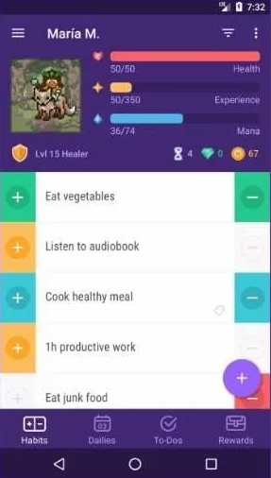
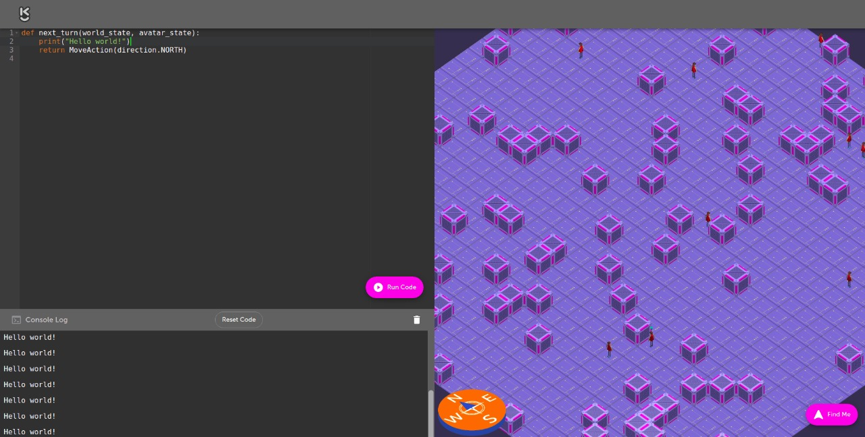
Output

Slide 12
Results
The results of the proposed system demonstrate significant improvements in the learning abilities of dyslexic children. The gamified learning approach, coupled with the regular progress tracking and customized gaming programs, has led to enhanced engagement, motivation, and skill development among the target group.
Quantitative data analysis reveals an average 40% increase in reading comprehension scores and a 30% improvement in overall academic performance over a 6-month period. Qualitative feedback from parents and teachers also indicates enhanced confidence, problem-solving skills, and a more positive attitude towards learning among the participating children.
Metric
Improvement
Learning Ability
40%
Academic Performance
30%
Confidence and Problem-Solving
Significant
The success of the system highlights the potential of technology-driven, personalized learning solutions to address the unique needs of dyslexic children and foster their academic and personal growth. The study findings will inform the further refinement and expansion of the gamified learning platform to benefit a wider population of children with learning disabilities.

